Slide 1
Topic: Geometry
EQ – How can we describe different objects?
We are now starting on the EST content

Slide 2


What are parallel lines?
ENGAGE DON’T WRITE
They are two lines on a surface that never meet. They are always the same distance apart.

Slide 3
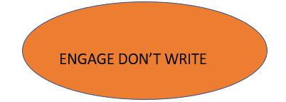
What is a Perpendicular Line?
This is when a line is at exactly 90 degrees to another line.
90 degrees!

Slide 4
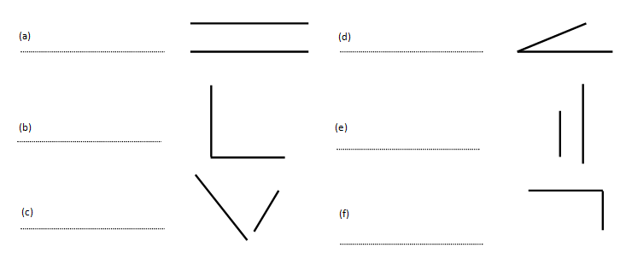
Quick Task:
Which of these shapes are parallel, perpendicular or neither?

Slide 5
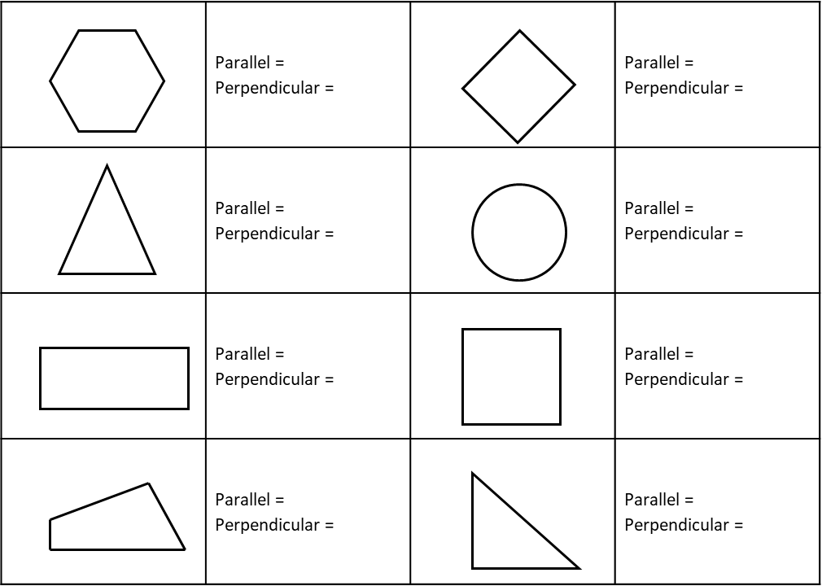
How many parallel or perpendicular lines are in each shape?
Now your turn

Slide 6
How many parallel or perpendicular lines are in each shape?
Now your turn

Slide 7
Geometry
Write these notes
EQ – How can we describe different objects?
Parallel lines are two lines on a surface that never meet. They are always the same distance apart.
Perpendicular lines meet at right angles (90º)
Another word for a shape is a POLYGON. They are named according to how many sides they have.
They can be Convex if all interior angles are less than 180º or concave if 1 or more interior angles are greater than 180^{o.}
Polygons can also be “regular” and “irregular” Regular polygons all have equal sides and angles. Irregular polygons have sides with different sizes and angles.
.

Slide 8
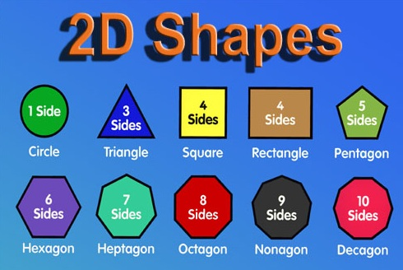

Slide 9
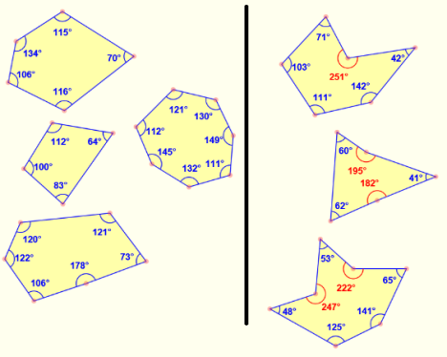
Polygons can be described as convex or concave.
Concave shapes only have interior angles less than 180º.
Convex shapes have at least 1 angle greater than 180º. This results in a “caved in” appearance on that side.
Convex
Concave
“Caved in”

Slide 10
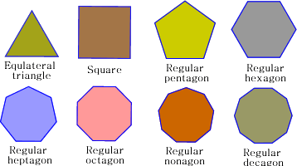
Regular polygons:
Regular polygons all have equal sides.
They have the same sized angles.

Slide 11
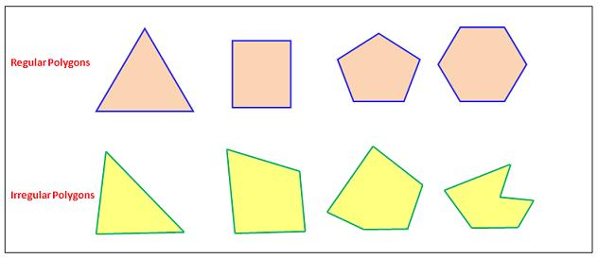
Irregular polygons:
Irregular polygons have sides of different sizes.
They have angles of different sizes.

Slide 12


Slide 13
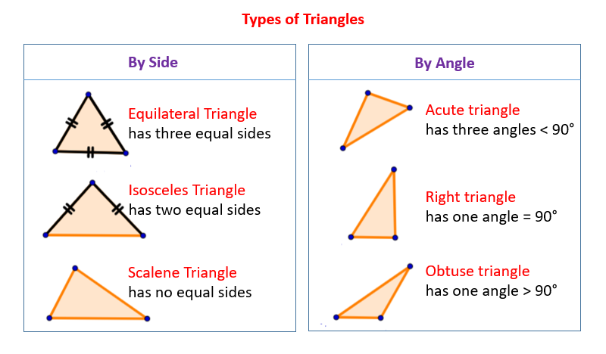

Slide 14
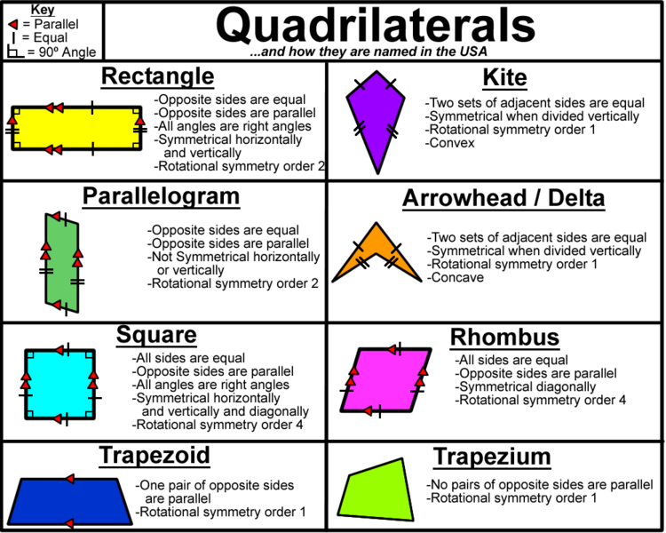
Glue in

Slide 15
Geometry
EQ – How can we describe different objects?
Parallel lines are two lines on a surface that never meet. They are always the same distance apart.
Perpendicular lines meet at right angles (90º)
Another word for a shape is a POLYGON. They are named according to how many sides they have.
They can be Convex if all interior angles are less than 180º or concave if 1 or more interior angles are greater than 180^{o.}
Polygons can also be “regular” and “irregular” Regular polygons all have equal sides and angles. Irregular polygons have sides with different sizes and angles.
.
Complete chapter 12 of MAWA Essentials book 3 and 4. Page 41

Slide 16
Geometry
EQ – How can we describe different objects?
Complete chapter 12 of MAWA Essentials book 3 and 4. Page 41
Practice is important here as this topic is the first of the topics covered in the EST

